Slide 1
General Federation of Women’s Clubs of Massachusetts
Dinner with the
GFWC Massachusetts
Leadership Team ~
Club Leaders Day
August 23, 2023
Moderator Terry Rouvalis,
GFWC MA 2nd Vice President

Slide 2
setting thE Table ~ AGENDA
Appetizers ~ lead to knowing our organization
Communications and Public Relations
State and Region Meetings
Diversity Statement
Entrees ~ what clubs can embrace
CSP, SP, AP
Contests
National Day of Service
Desserts ~ culminate your club work
Taxes
Report writing
GFWC MA ~ Do WE Have News for YOU
Club Leaders Day ~ August 27, 2022

Slide 3
APPETIZER GFWC and GFWC MA Advancement Plan (AP) Communications and Public Relations
GFWC MA Website ~
https://www.gfwcma.org/
GFWC MA FaceBook page ~ https://www.facebook.com/GFWCMA
GFWC Advancement and Programs Forum FaceBook page ~
https://www.facebook.com/groups/892214227854217

Slide 4
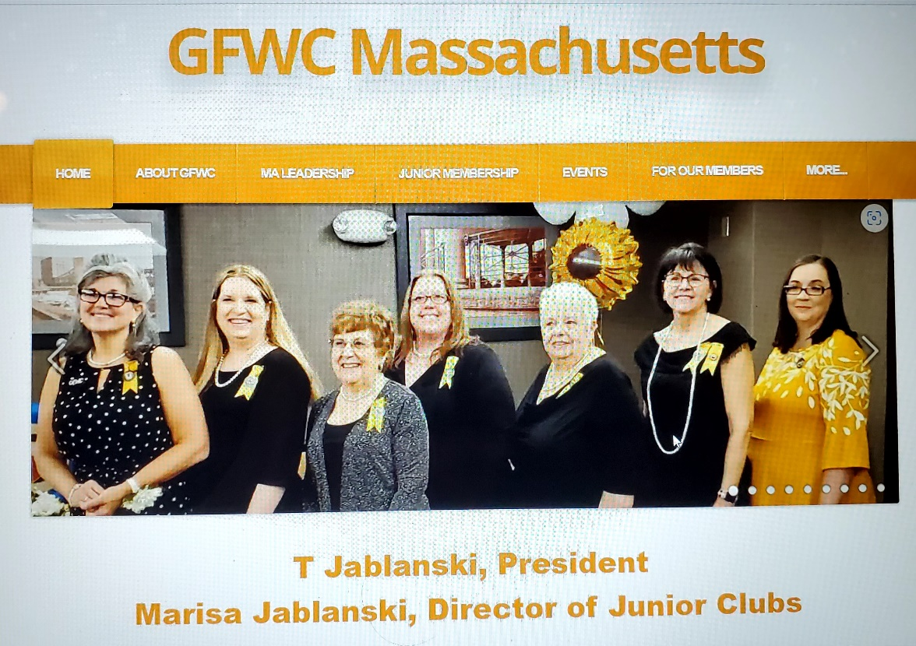
APPETIZER GFWC and GFWC MA Advancement Plan (AP) Communications and Public Relations
GFWC MA Website ~
https://www.gfwcma.org/

Slide 5
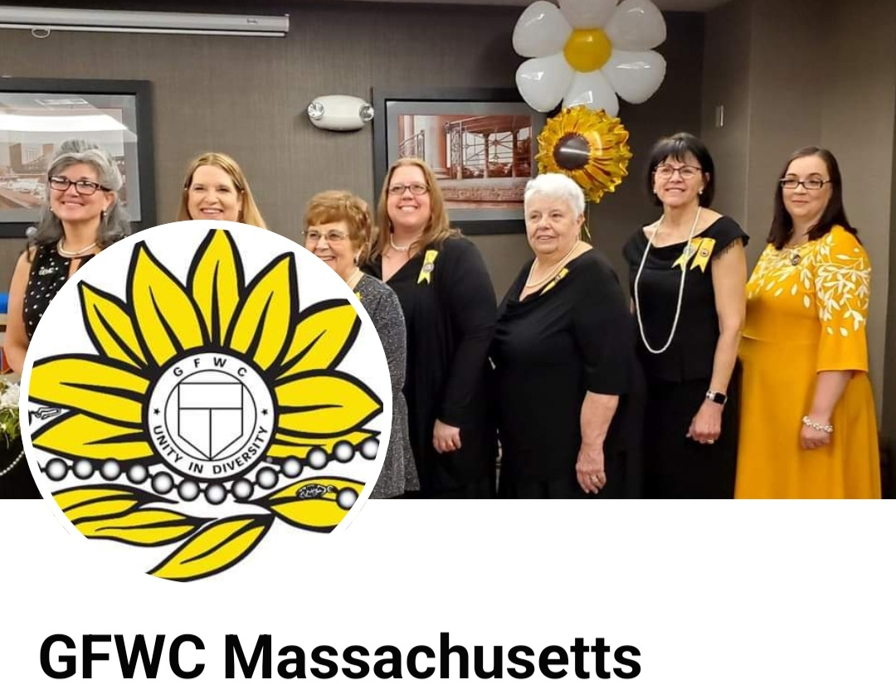
APPETIZER GFWC and GFWC MA Advancement Plan (AP) Communications and Public Relations
GFWC MA FaceBook page ~ https://www.facebook.com/GFWCMA

Slide 6
APPETIZER GFWC and GFWC MA Advancement Plan (AP) Communications and Public Relations
GFWC Advancement and Programs Forum FaceBook page ~
https://www.facebook.com/groups/892214227854217

Slide 7
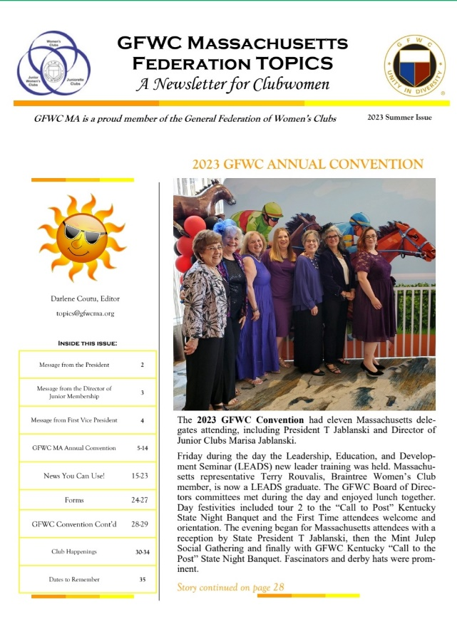
APPETIZER Newsletters
GFWC Massachusetts TOPICS
Your state newsletter
What is included in it
Share it

Slide 8
APPETIZER GFWC MA State Meetings and GFWC Region Meetings
GFWC New England Region Meeting ~ September 22-24 @ Rocky Hill, CT
GFWC MA Fall Meeting ~ October 29 @ Publik House, Sturbridge
GFWC MA Midwinter Meeting ~ January 20 @ Wrentham Senior Center, Wrentham
GFWC MA Annual Convention ~ May 3 and 4 @ Courtyard Marriott, Marlborough
Why it is important to attend?

Slide 9
APPETIZER GFWC and GFWC MA Advancement Plan (AP) Communications and Public Relations
Diversity, Equity, and Inclusion Statement
​The General Federation of Women's Clubs (GFWC), one of the oldest women's volunteer organizations, seeks to build global communities where people unite in diversity and dedicate their service to changing lives. GFWC celebrates the engagement of people of all backgrounds and believes in fostering an inclusive, equitable climate and culture where community members can thrive.

Slide 10
ENTREE GFWC and GFWC MA Special Programs (SP), Community Service Programs (CSP) and Advancement Plans (AP)
GFWC Signature Program: Domestic and Sexual Violence
Awareness and Prevention
GFWC Juniors’ Special Program: Advocates for Children
Arts & Culture
Civic Engagement and Outreach
Education and Libraries and ESO
Environment
Health and Wellness
Fundraising
Legislation/Public Policy
Leadership
Membership
Women’s History and Resource Center (WHRC)

Slide 11
ENTREE GFWC Contests
Photography Contests ~ Clubwomen
Writing Contest ~ Clubwomen and Youth
Community Impact Program Award
Why enter?

Slide 12
ENTREE GFWC National Day of Service September 30, 2023

Slide 13
DESSERTS Taxes
IRS Determination Letter
IRS needs more information
IRS needs more information ~ what is needed
Email from the Commonwealth of Massachusetts
Commonwealth Annual Report for the State of Massachusetts

Slide 14
DESSERTS Taxes ~ IRS Determination Letter

Slide 15
DESSERTS Taxes ~ IRS needs more information

Slide 16
DESSERTS Taxes ~ IRS needs more information ~ what is needed

Slide 17
DESSERTS Taxes ~ email from the Commonwealth of Massachusetts

Slide 18
DESSERTS Taxes ~ The Commonwealth of Massachusetts ~ Annual Report

Slide 19
DESSERTS Report Writing
Why is it important to report
Statistical Form
Recording donations, hours, in-kind
How to write a good project report
Tips to tell a story with your report

Slide 20
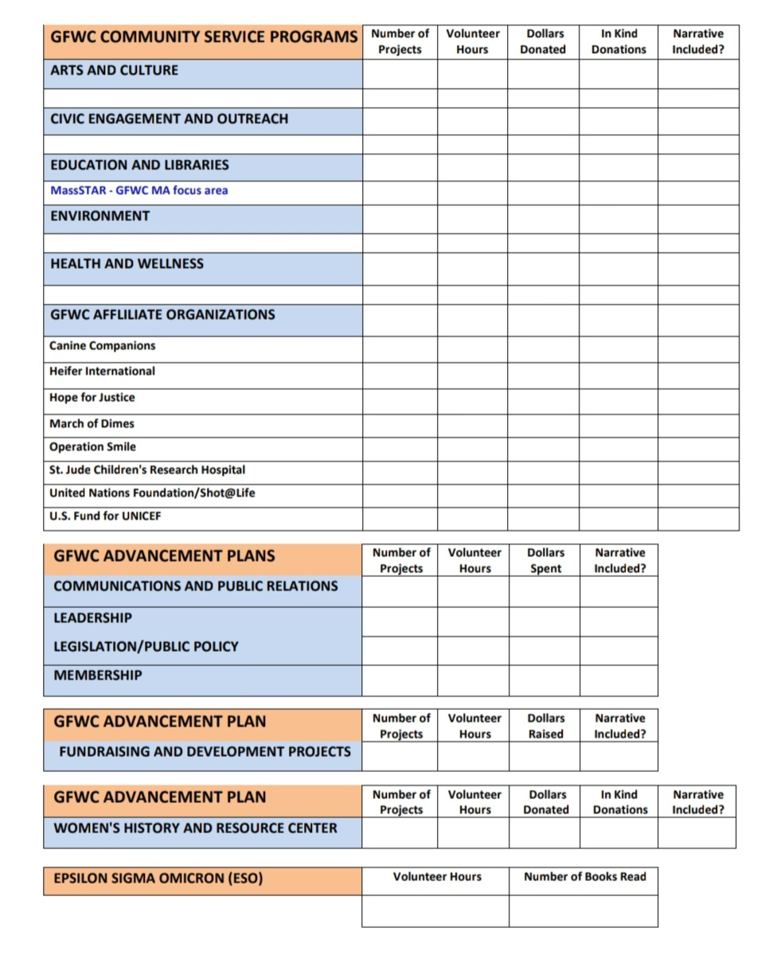
DESSERTS Report Writing ~ Statistical Form

Slide 21
DESSERTS Report Writing ~ Sample Project Form Heading

Slide 22
DESSERTS Report Writing ~ GOOD, BETTER, BEST
GOOD
Anytown clubmembers held our annual Halloween costume parade for the elementary school. Many children showed up and families donated canned goods for the local food pantry. We gave out prizes to winning costumes and sent in an article to the newspaper afterwards.
BETTER
GFWC Anytown Woman’s Club held their annual Halloween costume parade for the Anytown Elementary School. Over 40 families showed up and participated. Families brought canned goods for the food pantry. Prizes were awarded and a press release went to the newspaper following the event with pictures. 6 members spent 4 hours preparing and executing this event.
BEST
Halloween Costume Parade – 6 members/24 hours/68 items donated ($98 in kind)
GFWC Anytown Woman’s Club held their Annual Halloween costume parade for the Anytown Elementary School, with over forty families in attendance. In order to participate in the parade, families were encouraged to bring a donation for the school’s food pantry. AJWC was proud to deliver over 68 items to the food pantry the following week. When prizes were awarded to the winning children, pictures were taken and a press release was then drafted and sent to the town newspaper for publication.

Slide 23
Thank you for attending

